Slide 1


RAD SALES TRAINING

Slide 2
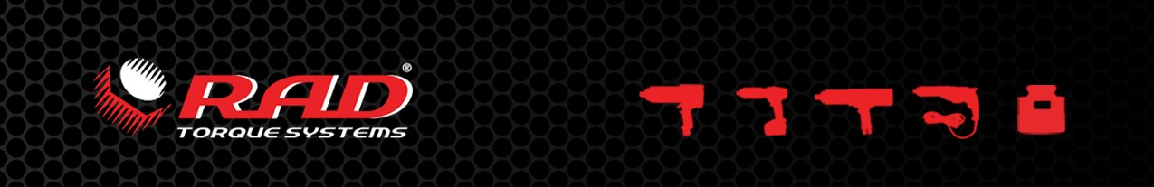
Highlights RAD
World’s only manufacturer that only specializes in torque multipliers
High product innovative development focus
20 years of experience in gearbox technology
Our tools outperform competition on weight, size and reliability
Wide range of reaction arms, nose extensions available
Many custom products
Advanced datalogging and tool software available

Slide 3
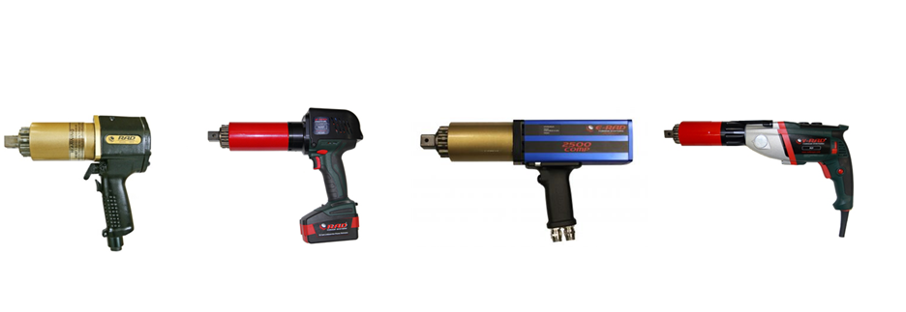
Product range
Pneumatic
(Digital) Battery
Electronic
(Digital) Electric

Slide 4
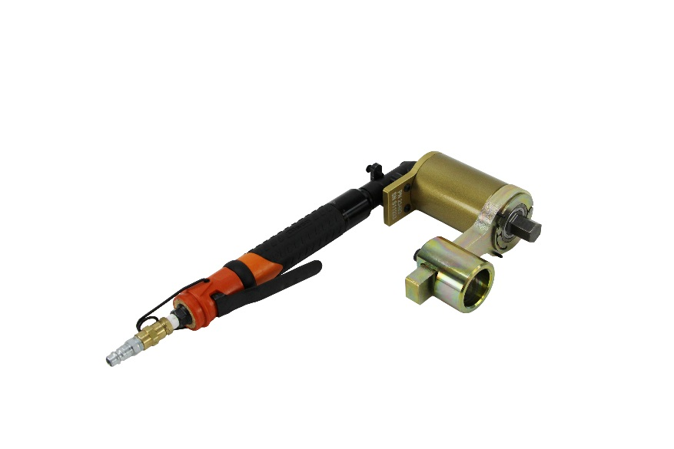
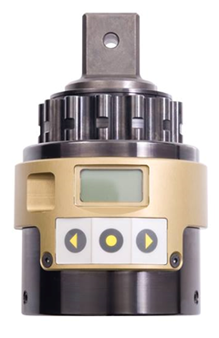
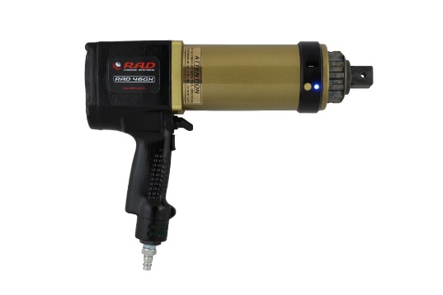
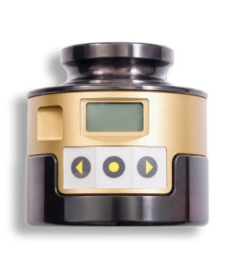
Product range - 2
RT
Remote Transducer
RAD-TV
(Transducer verified)
Smart Socket
SDM Low profile

Slide 5
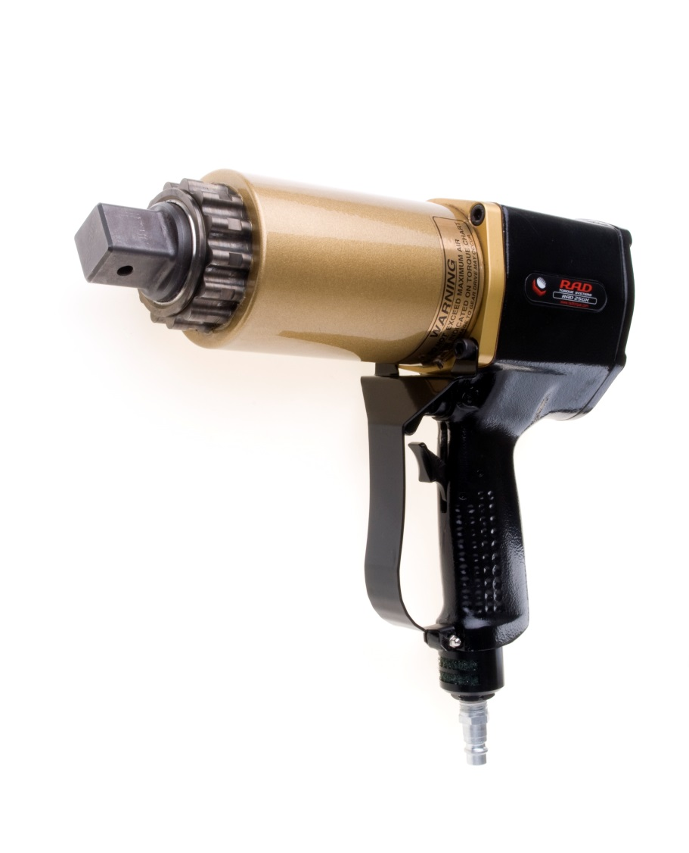
Pneumatic
Patented gear system
Up to 11.500nm
Forward & reverse
Adjustable torque / speed
Accuracy +/- 4% on target
Extreme reliable design
Very compact & fast
Rotating annulus( for
positioning reaction arm)
Automatic speed adjustment
(2-speed models)

Slide 6
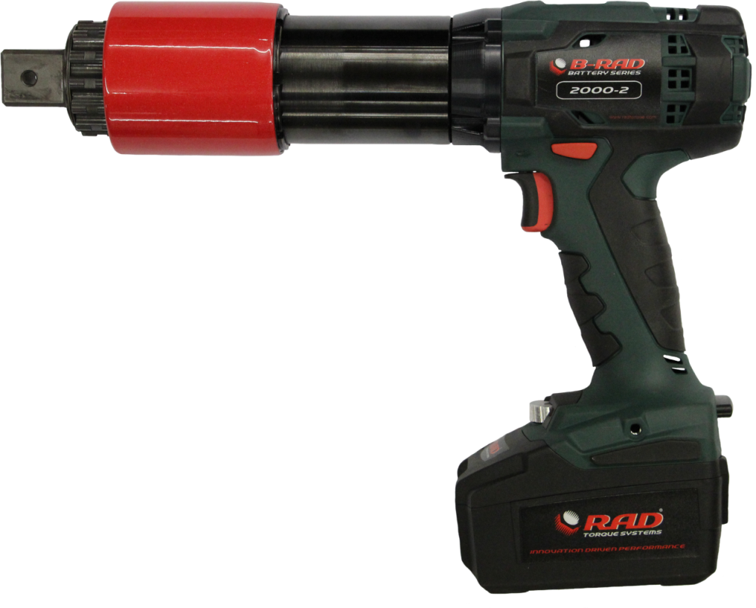
New B-RAD series
New handle design
Models: 100,275,475,700(-2),950-2 1400(-2), 2000(-2)
High speed model: 950Nm – 58RPM
Accuracy +/- 5% on target
In development: 4000nm
30% more speed with new motor
5,2Ah batteries standard
Electric shut off – 8 settings
Better cooling

Slide 7
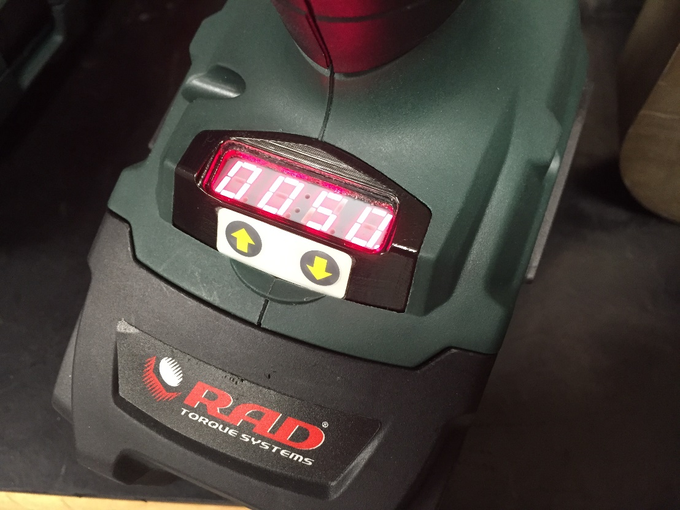
New B-RAD series
Setting per 10Nm
Accuracy of +/- 5% on target

Slide 8
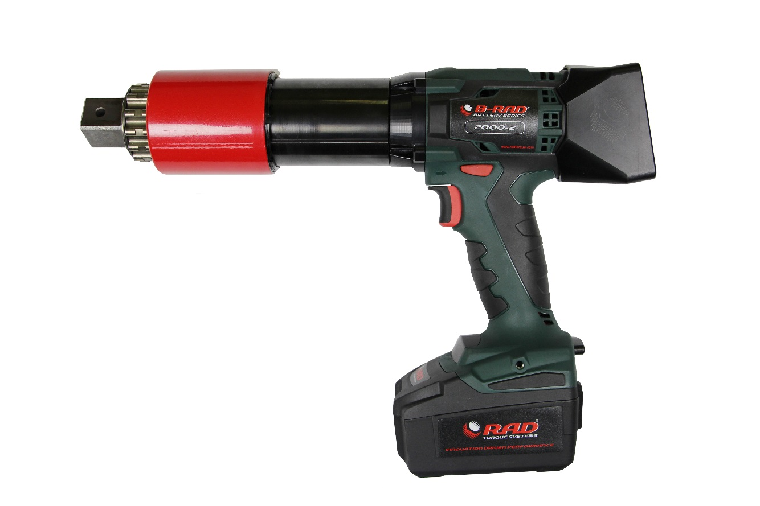
DB-RAD series
Torque setting per Nm
3 user levels in menu
From 68Nm up to 2000Nm
Programmable presets
Pass / fail indication
Accuracy +/- 5% at target
Field calibration possible with SS
Li-Ion battery 5,2Ah technology
Rotating annulus
New model since 2015

Slide 9
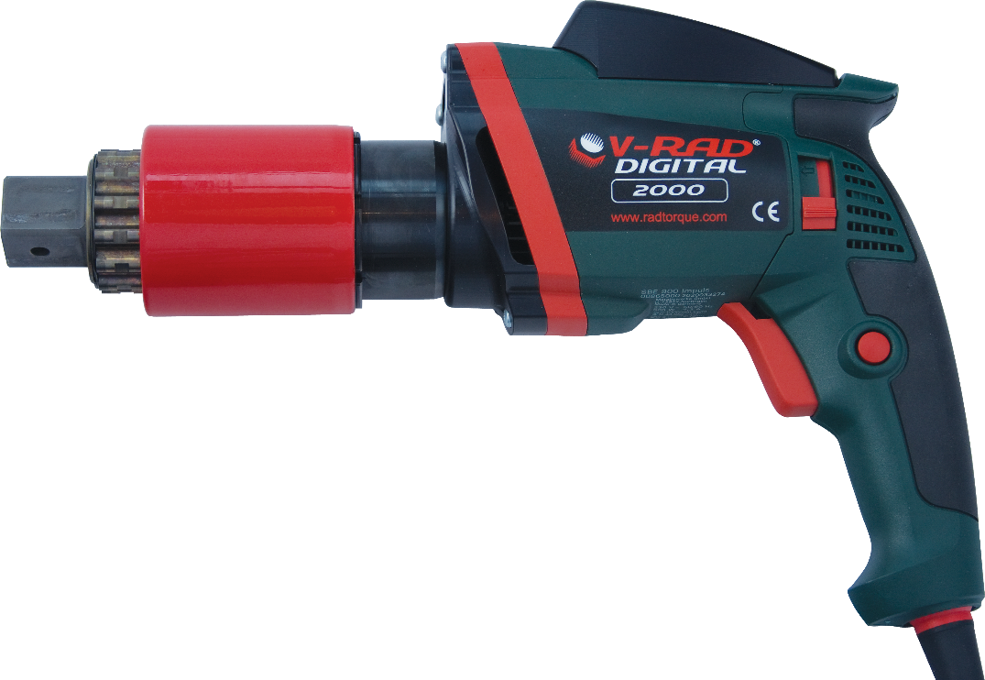
DV-RAD series
Torque setting per nm
Up to 3.400Nm torque
Programmable presets
Accuracy +/- 5% on target
Field calibration with SS
Rotating annulus
Used by Enercon, Siemens,
Vestas

Slide 10

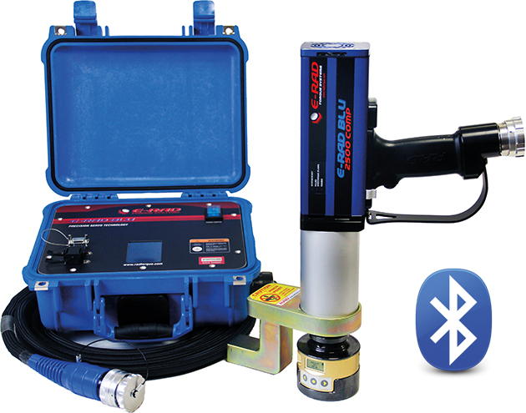
E-RAD BLU series
Servo controlled torque wrench
Torque setting per Nm
Angle function
From 135 to 15.000Nm
Programmable presets
Accuracy +/- 2,8% on target
Field calibration with SS
Rotating annulus
Used by Enercon, Siemens,
Vestas, Nordex, Certion

Slide 11
E-RAD BLU series
Most advanced electric torque wrench on the market
Ideal for heavy duty usage, high speed and high cycles
Multiple models wrenches can be used in combination with one controller. Reducing cost when multiple wrench sizes are needed.
Bluetooth connectivity with RAD Smart Socket for transducer verified joint calibration
More advanced data logging and tool management features
Single cable and connector system
Very suiteable for steel construction, Wind turbine installation, engines, off shore work.

Slide 12
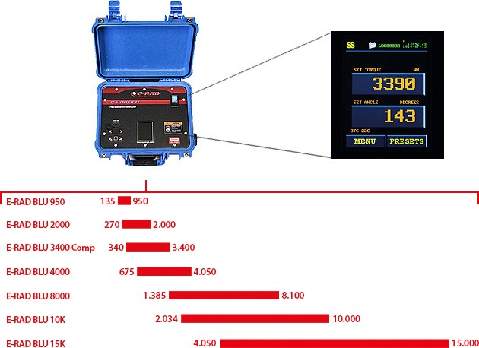
E-RAD Range:

Slide 13
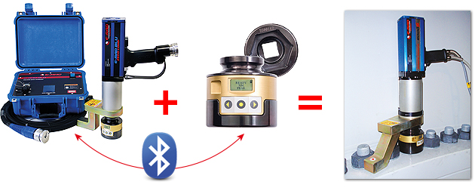
E-RAD BLU
Smart socket on site joint verification

Slide 14
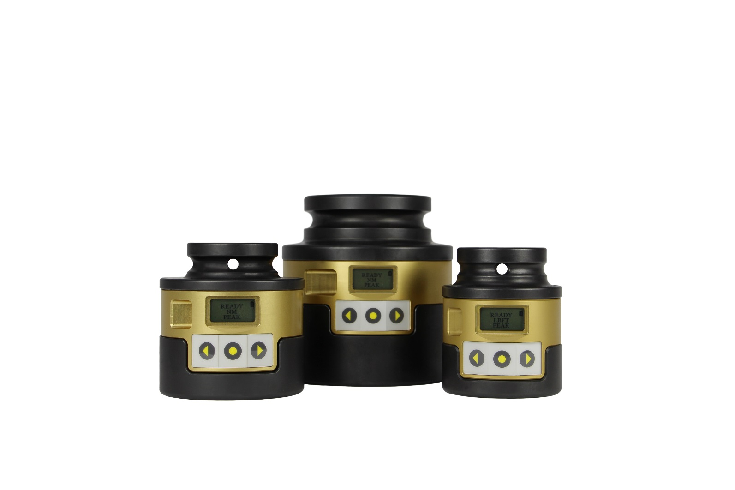
Smart Sockets
Can be fitted on hydraulic, manual, electric wrench etc.- Up to 10.800 NM - Not suitable for impact wrenches.
Perfect for field checking of applied torque
Enables high accuracy (< 0.8%) with standard tools
Pass – Fail indication
With data logging software
Sizes: 33, 36, 41, 46, 50, 55,
60, 65,70, 80mm A/F
Exova approved & verified

Slide 15
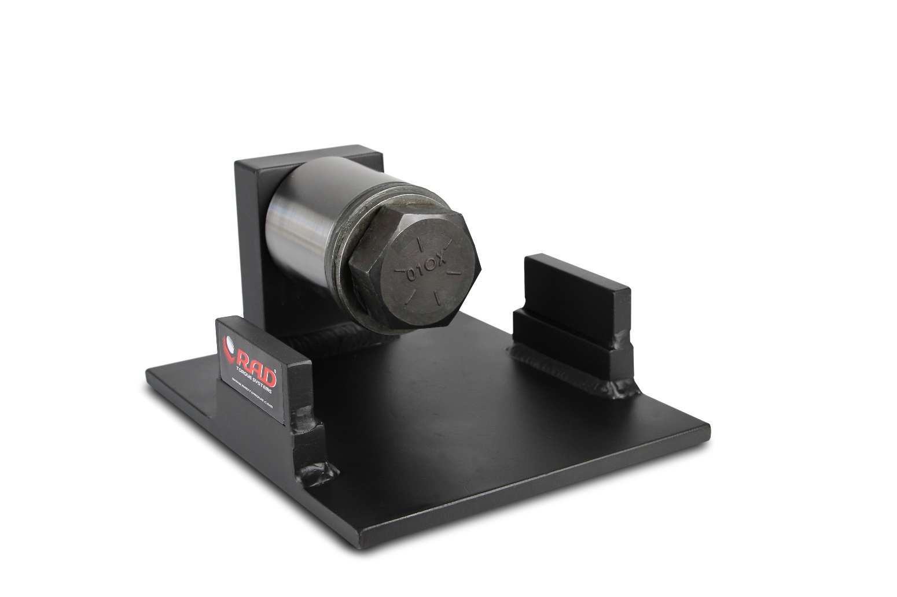
RAD Calibration benches
Easy to use calibration bench for TM tools
Can be used in Van for mobile application
Transducer calibrated to 0,5% accuracy
Up to 8000 NM

Slide 16
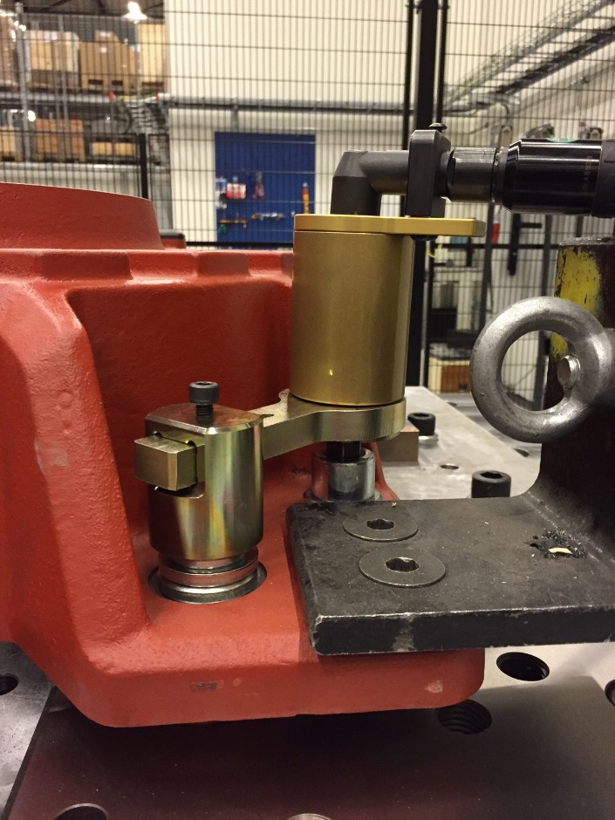
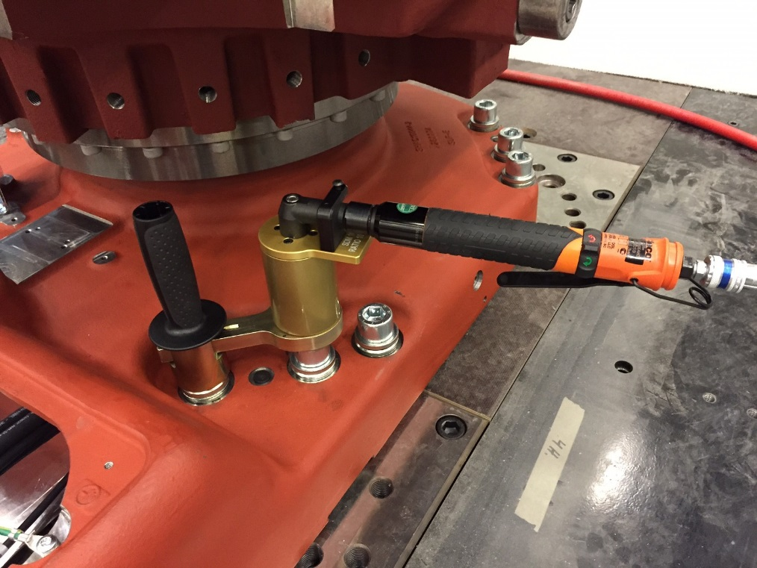
SDM gearboxes

Slide 17

Pneumatic multiplier vs. hydraulic wrench

Slide 18
Key benefits RAD TORQUE SYSTEMS:
Torque is very smooth applied by continuous rotation
Minimum triple the speed of hydraulic wrenches
Much safer – no high pressures like hydraulic tools, better handling, low risk of pinching
Very ergonomic
No vibrations (unlike impact wrenches – HAVS injuries)
Very low noise level
Low weight - no pump needed
High variation in reaction arms possible – more applications

Slide 19
Please note:
Our range is up to Max 15.000 nm
Our standard tools do not work under water
Low profile is more difficult
Air supply must be according requirements (6-8bar pressure
& enough volume)
Electric tools require ground connection
Good reaction point / arm is of key importance!

Slide 20
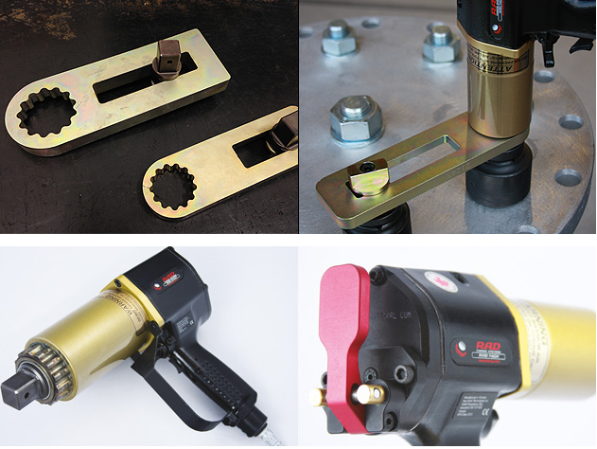
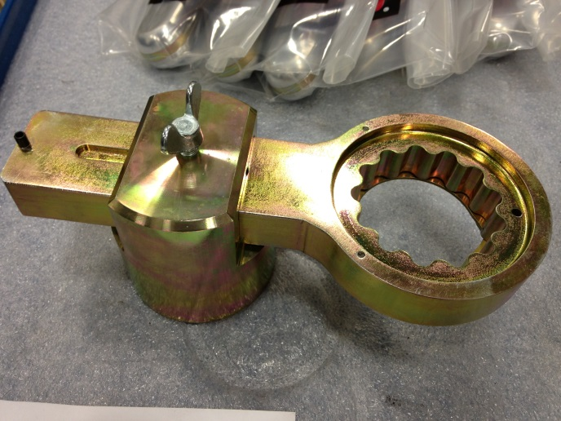
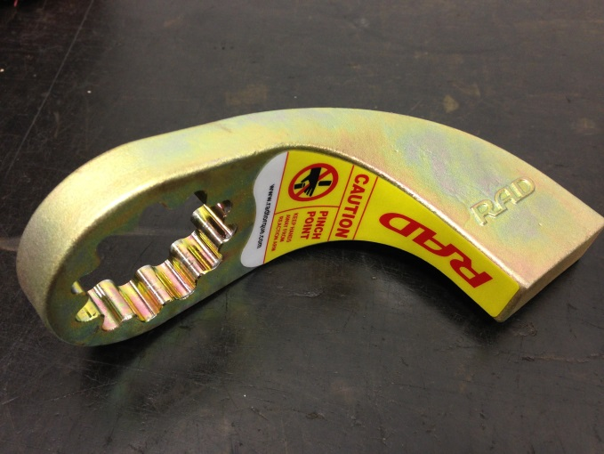
Safety

Slide 21
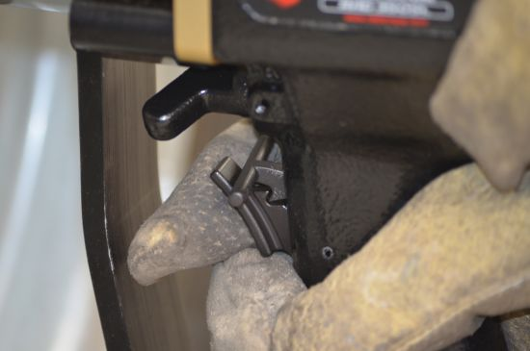
Safety – trigger lock

Slide 22
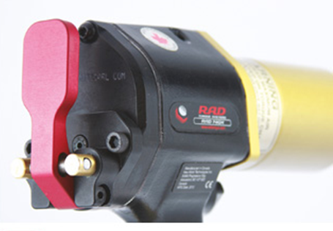
Safety – safety valve
http://www.youtube.com/watch?v=RltTzA2xWtA

Slide 23
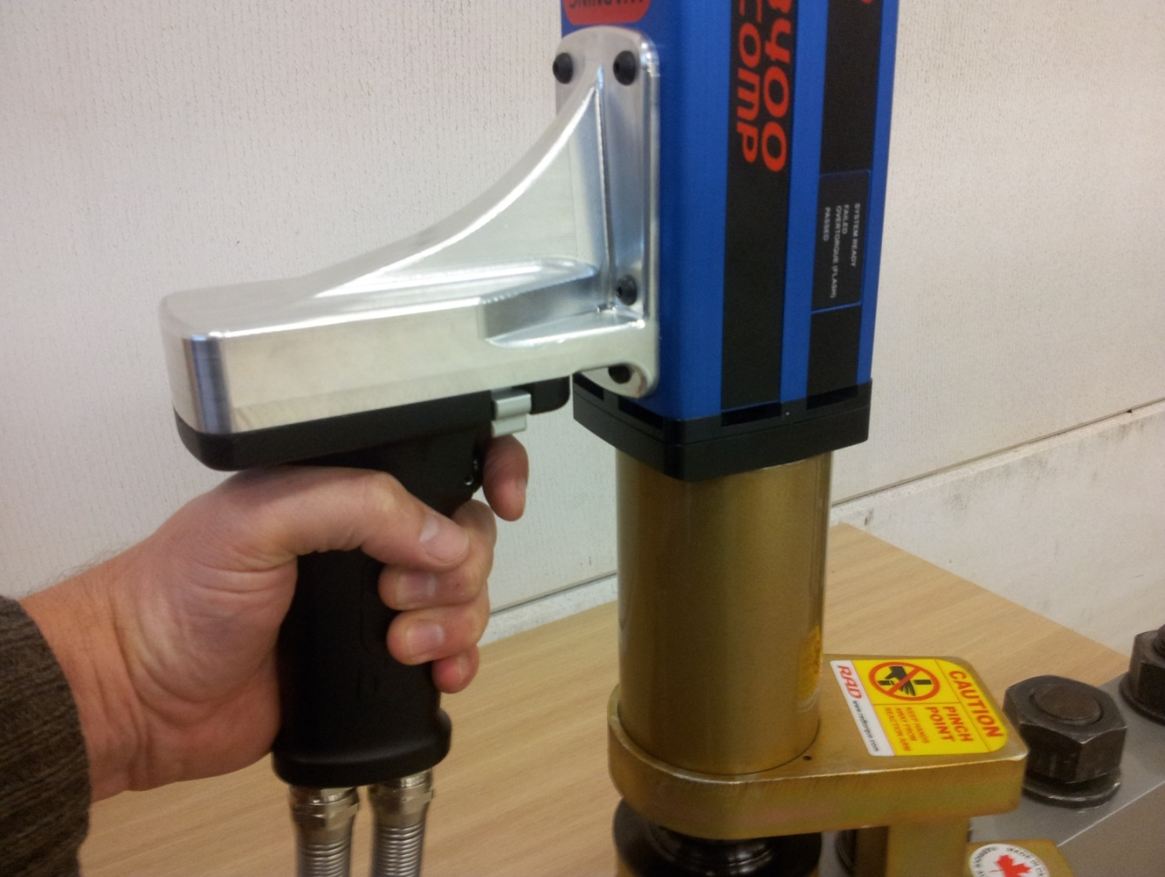
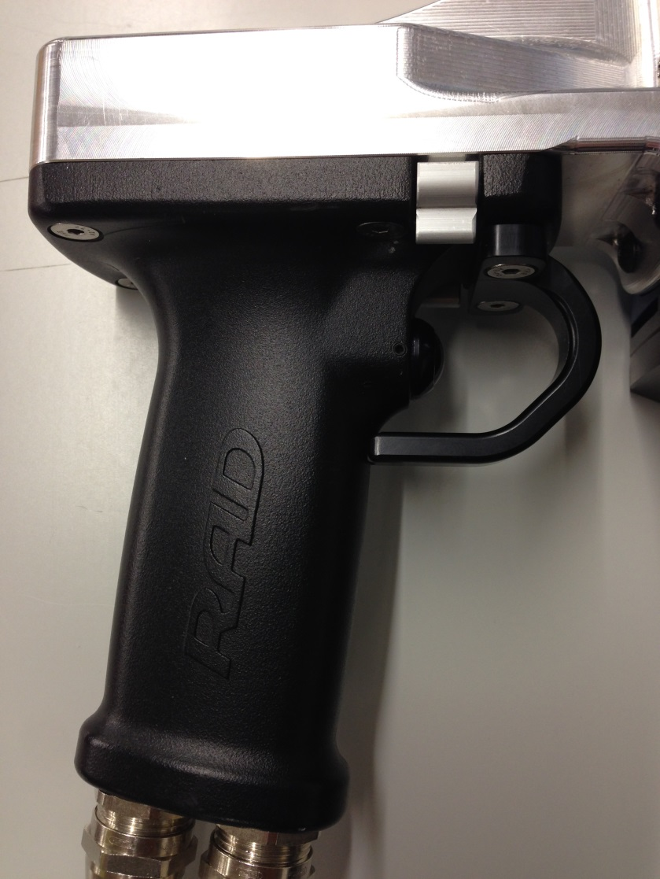
Safety - 90° handle

Slide 24
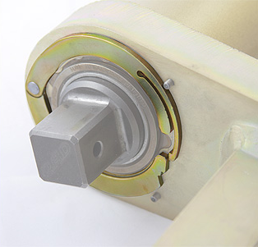
Safety – self retaining arms

Slide 25
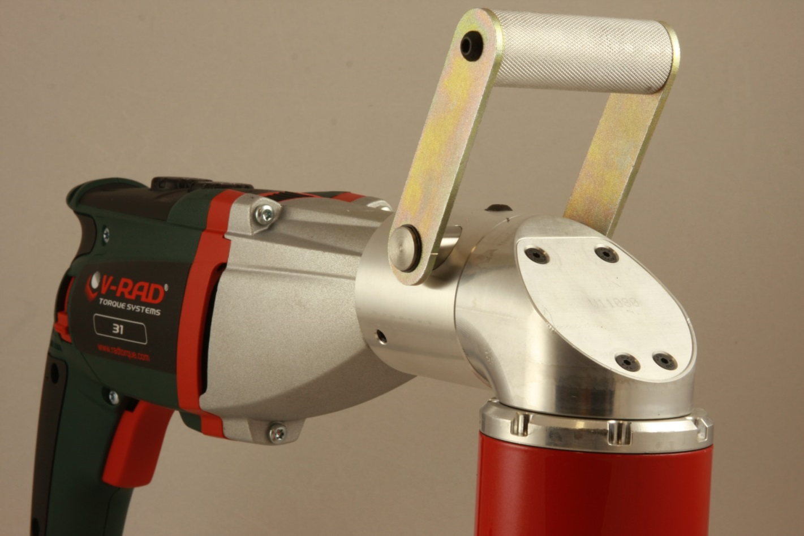
90° tools

Slide 26
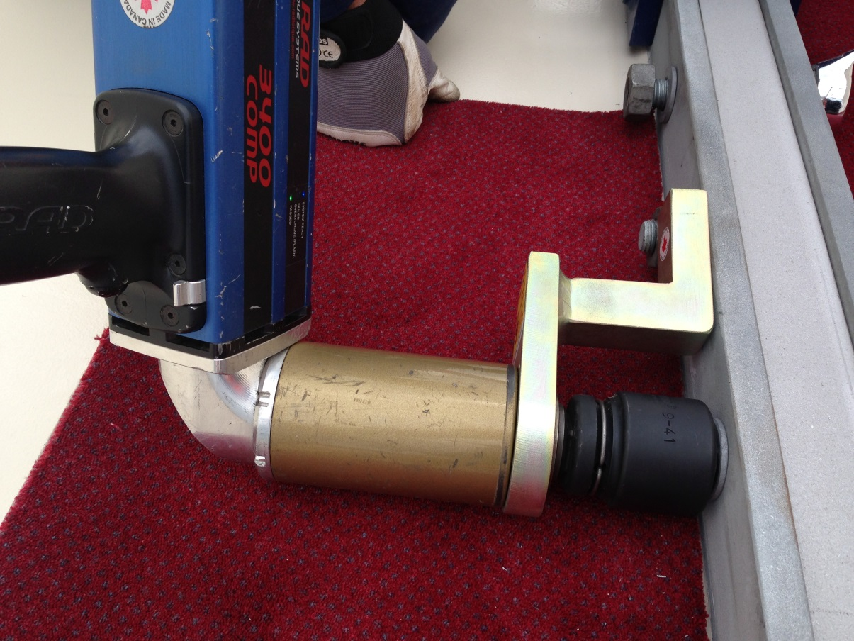
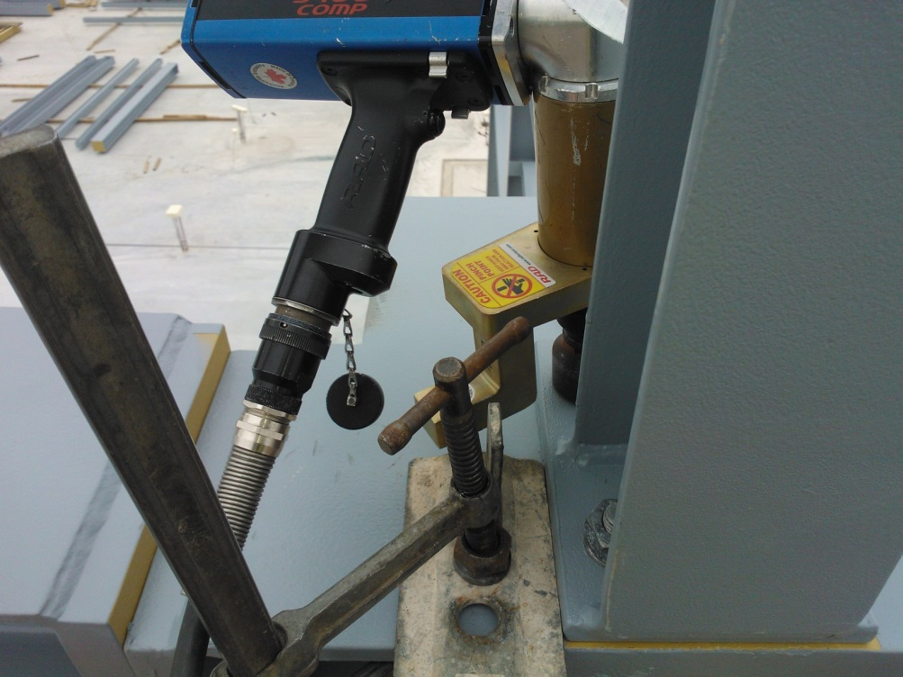
90° tools

Slide 27
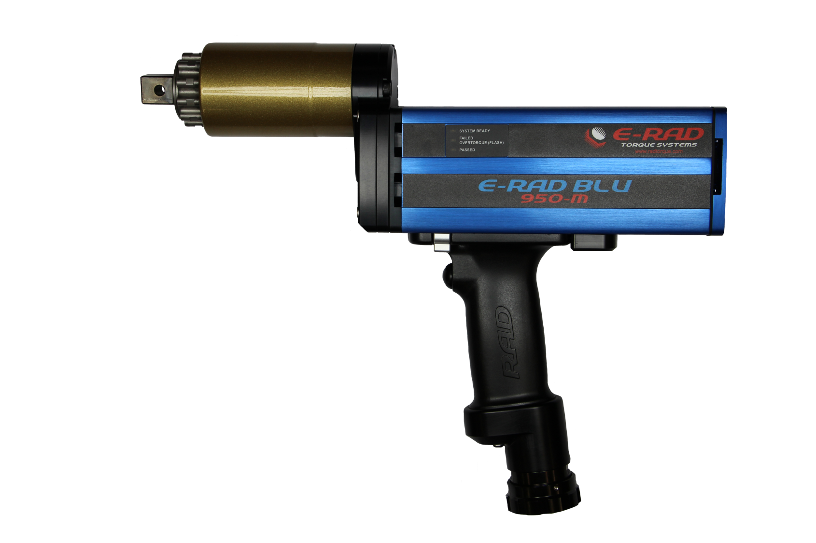
Specials – integrated offset gearbox

Slide 28
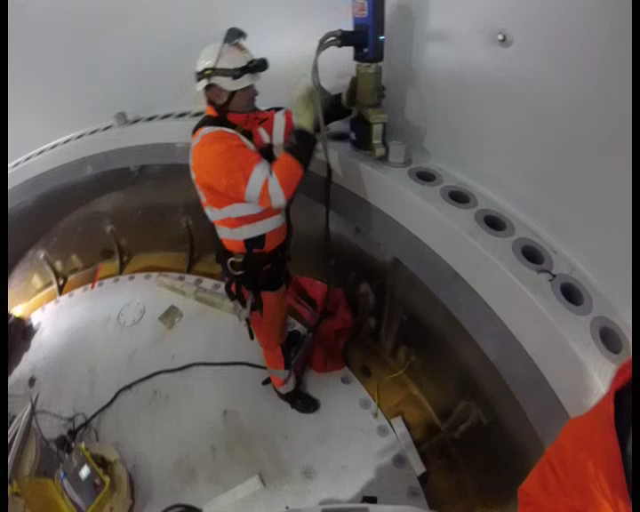
Inside a wind turbine:

Slide 29
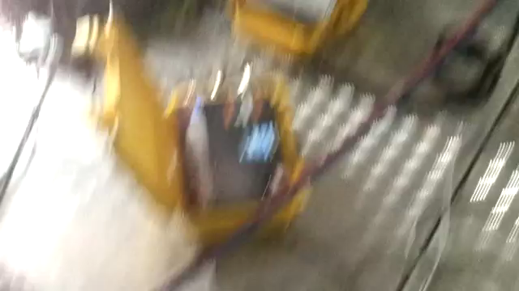
E-RAD versus Hydraulic wrench:

Slide 30

YouTube channel
https://www.youtube.com/user/RADTORQUE

Slide 31
Thank you for your attention

