Slide 1
Solutions for the wind industry

Slide 2
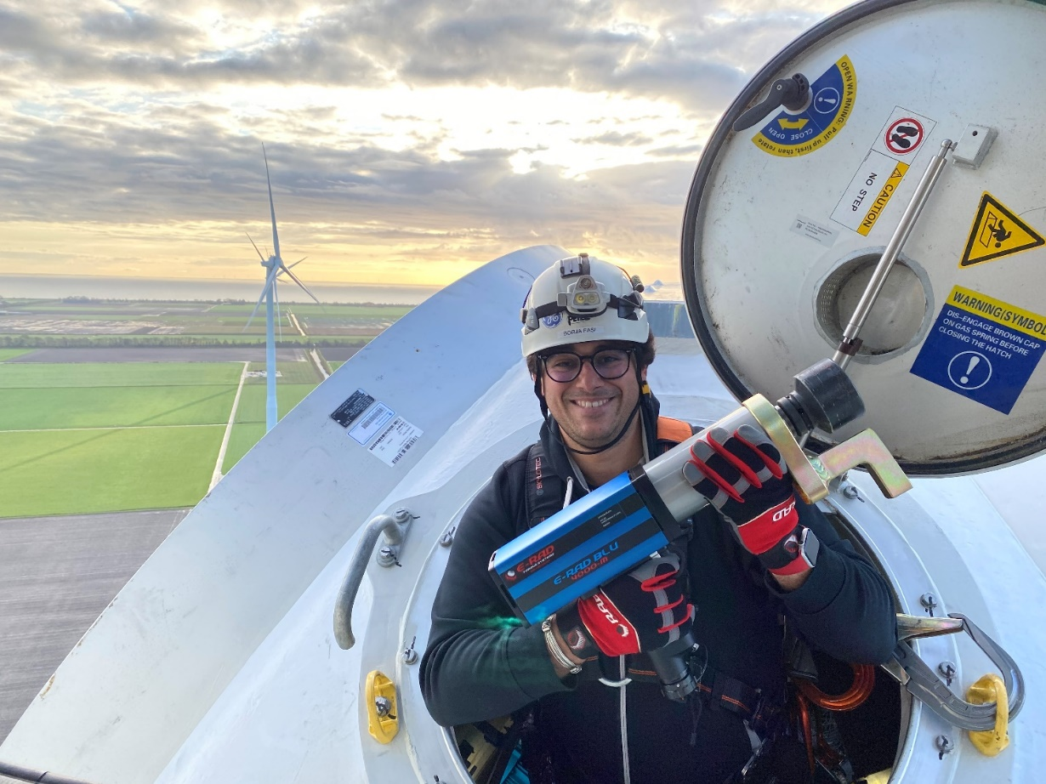
Contents
Wind industry in general
Trends in the industry
Radial Torque Tools for the wind industry
The steps in the supply chain
Competitors

Slide 3
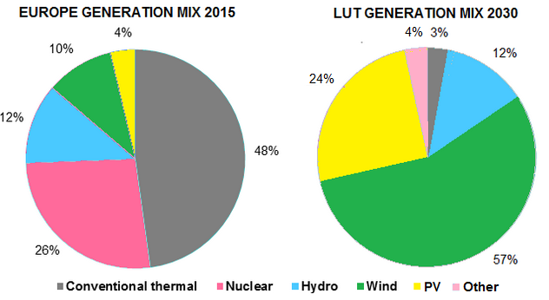
The wind industry - general
Energy mix Europe:
Wind is growing fast
Lappeenranta University of Technology (LUT)
2015 - 2030 European growth calculation →
DNV (Det Norske Veritas)
charts the world’s wind fleet growth
from 709GW at the beginning of 2020, to
1TW in 2022, 2TW in 2029, 4TW in 2043
and 5.9TW in 2050.
This 5.9TW will include 1.7TW of offshore
wind

Slide 4
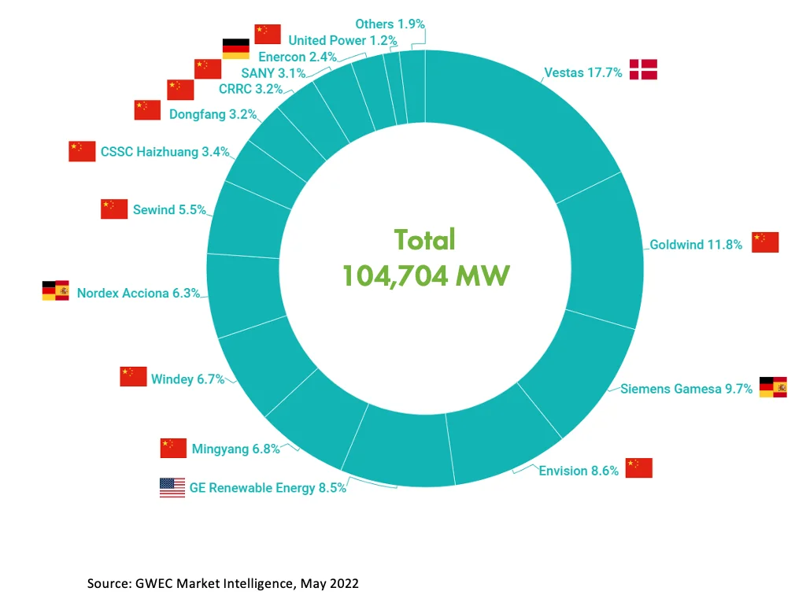
Wind Turbine manufacturers
World top 10 in 2022 (Source: BizVibe) GWEC 2022 ranking (Source: Global Wind Energy Council)
Rank | Company | Headquarters | Total Capacity (Gigawatts)
1 | Vestas | Aarhus, Denmark | 9.60
2 | Siemens Gamesa | Biscay, Spain | 8.79
3 | Goldwind | Beijing, China | 8.25
4 | GE | Boston, U.S. | 7.37
5 | Envision | Shanghai, China | 5.78
6 | MingYang | Zhongshan, China | 4.50
7 | Windey | Zhejiang, China | 2.06
8 | Nordex | Hamburg, Germany | 1.96
9 | Shanghai Electric | Shanghai, China | 1.71
10 | CSIC | Chongqin, China | 1.46

Slide 5
RAD torque tools – approvals
E-RAD approved (for final torque) by:
- Vestas, several hundreds E-RADs in use – In Europe & North-America
- Siemens – 8000-S is fully approved, 4000-S used in North-America, B-RAD BL 2000-2 with Smart Safety Trigger
- Enercon – 1.000+ RAD tools. Globally used, bought in Germany
- GE – Several hundreds E-RAD in use – various sizes - in Europe and North-America
- Nordex, all E-RADs

Slide 6
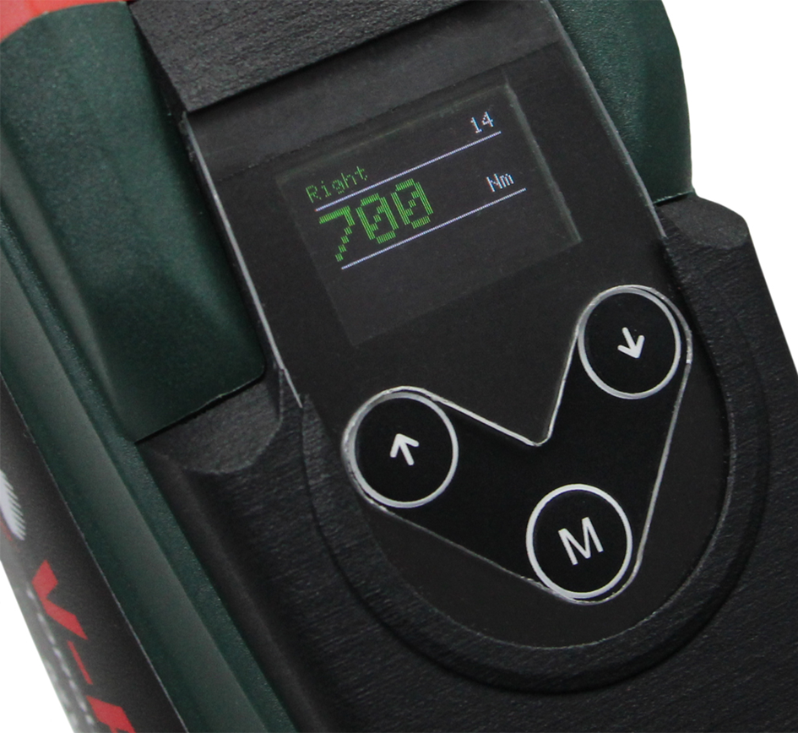
Key benefits using RAD Torque tools
Speed, see video in link below
Easy to use
Light weight compared to hydraulic kit
Digital torque setting
Data logging
Optional transducer versions
Etc.
https://www.youtube.com/watch?v=YLlydGOl8Nw

Slide 7
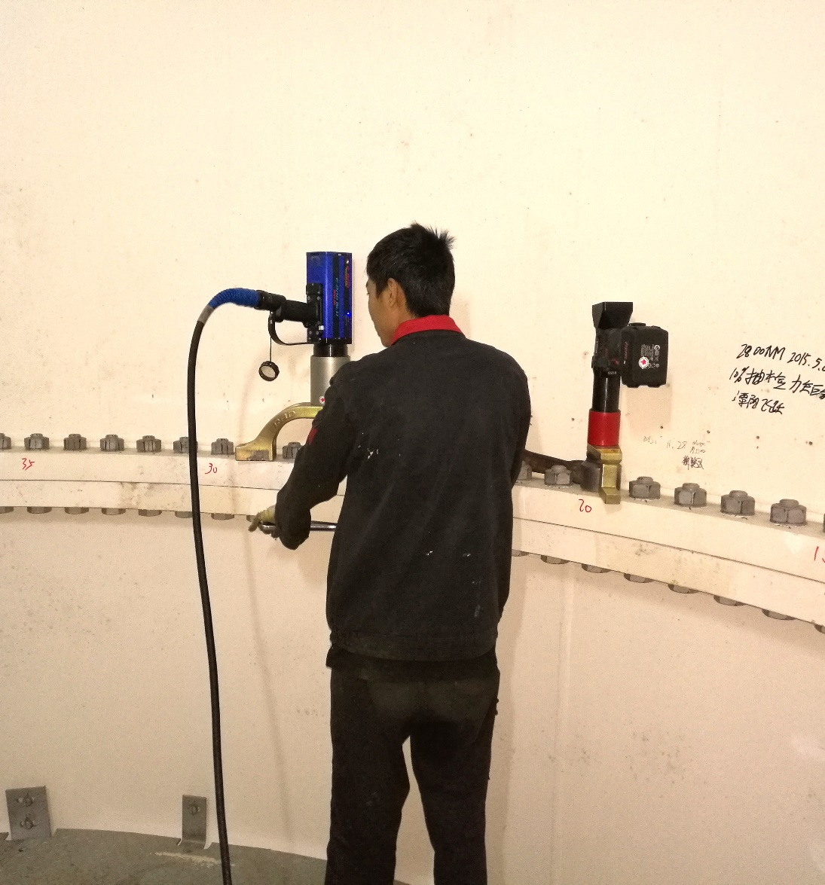
RAD tools for the wind industry
RAD battery tools
RAD electric tools
RAD Smart Socket
Radial flange roller
E-RAD Live

Slide 8
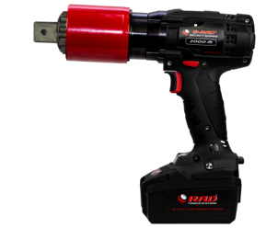
RAD tools, battery
B-RAD Select
Range: 50 – 7.000 Nm
B-RAD SELECT 2000-2 standard tool for pre-torque jobs

Slide 9
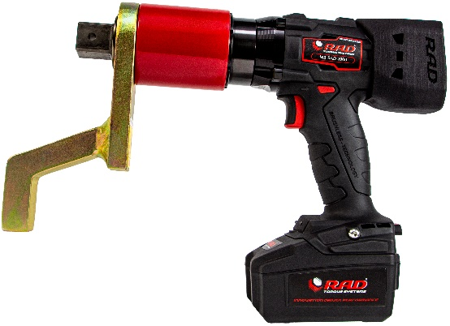
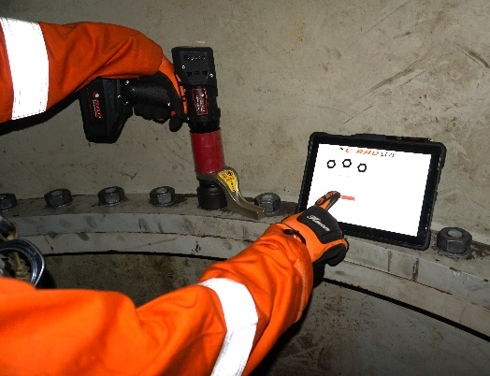
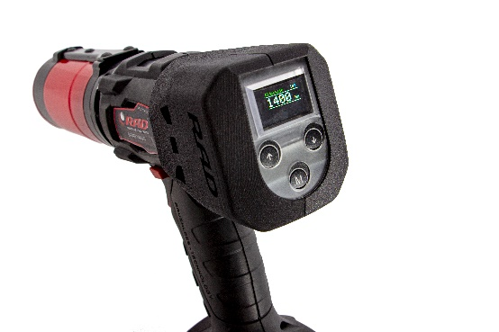
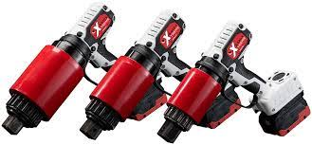
RAD tools, battery
MB-RAD, 30 – 7.000 Nm
Torque plus angle, presets, limits, etc.
Torque check program
Data log of bolting process
B-RAD S, 70 – 7.000 Nm
All of the above but transducerized
B-RAD X, 700 – 15.000 Nm
The world’s most powerful battery torque wrench
Up to 15.000 Nm

Slide 10
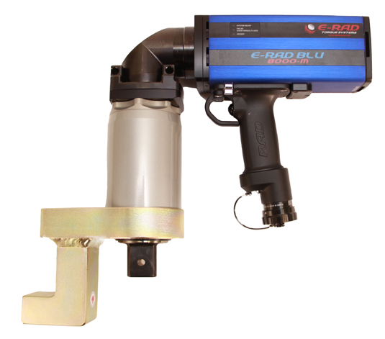
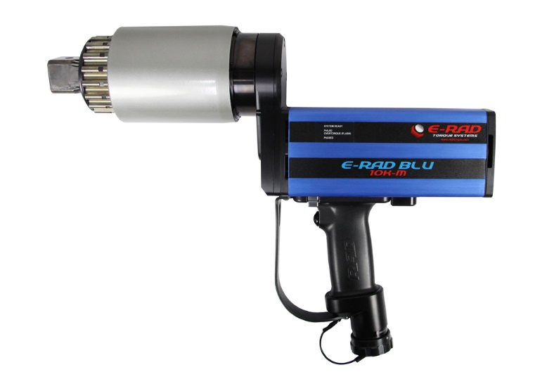
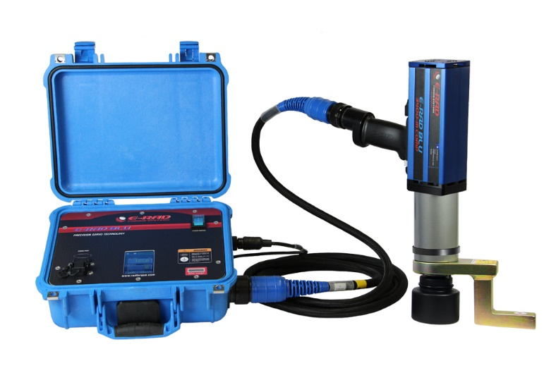
RAD tool, electric
E-RAD (S)
Torque range 135 – 16.500 Nm
Bluetooth connectivity with RAD Smart Socket™ for transducer verified bolt connection calibration
Highly advanced data logging capabilities and torque wrench management features
Military grade single cable connection system
Password protection on 3 user levels: basic, intermediate and advanced
Operator identification – Ensures traceability of each torque sequence performed
Capable of tightening bolted connections with torque and angle
LED indicator lights (Pass/Fail)
Controlled bolting – repeatability of +/- 2%
Available in straight, offset and 90 degrees versions
The E-RAD S is the transducerized version, this
measures and corrects the applied torque during bolting

Slide 11
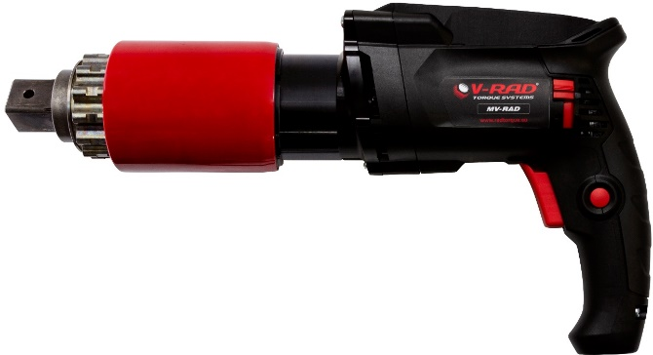
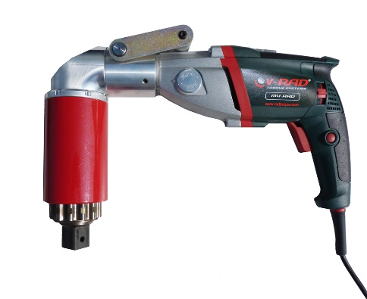
RAD tools, electric
MV-RAD
Torque range 65 – 11.000 Nm
Very light and easy to use
Stops automatically when the set torque is reached and the torque arm is released from the bolt connection
Pistol grip with membrane key and OLED-Display
360° rotatable handle
Torque setting per Nm
Angle function
Bolt check function (optional)
Controlled bolting – repeatability of +/- 3%
Available in straight and 90 degrees versions

Slide 12
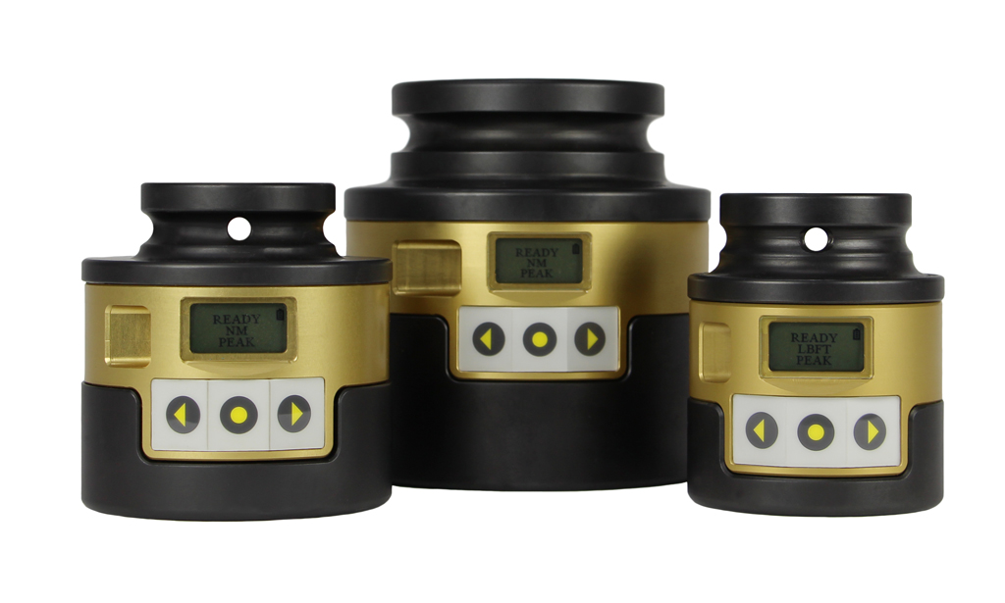
RAD tools, Smart Socket
Smart Socket
Measures and displays peak torque
Built-in rechargeable li-ion battery
“Pass”/ “Fail”, Track and Peak function
Data logging – download logs (XLS, CSV, PDF)
Full traceability of bolted joints
Bluetooth connectivity
Graphics live view function
Preinstalled tablet
2 main functions in wind:
Bolt quality control
Tool torque check

Slide 13
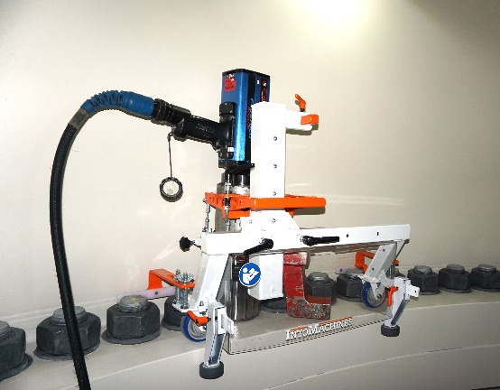
Radial tools
Flange roller for E-RAD, MV-RAD and B-RAD X

Slide 14
Wind industry – customer types
RAD torque wrenches are used in these ‘steps of the supply chain’
Parts manufacturing
Complete assembly
Transport (on and offshore)
Turbine erection
300 hours service
Service & repairs
Certification labs
Turbine recycling

Slide 15
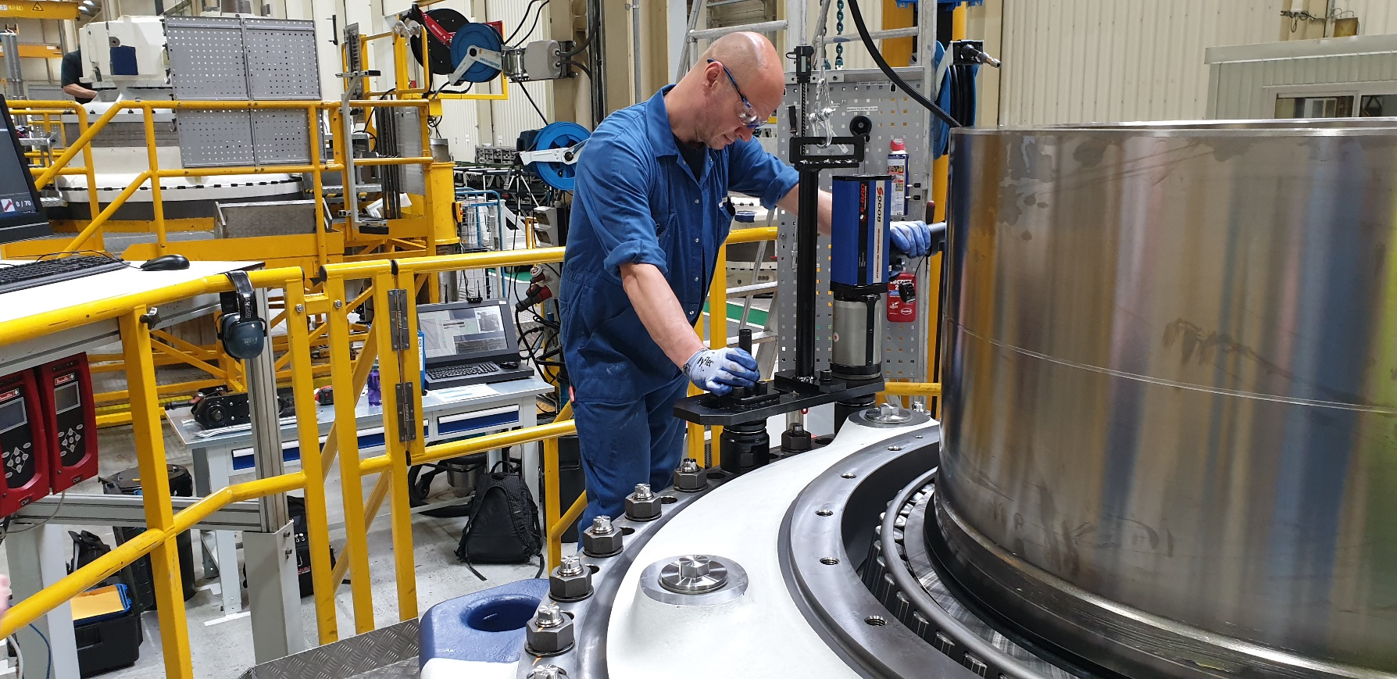
Component manufacturing
Gearbox, ZF, Lommel Belgium

Slide 16
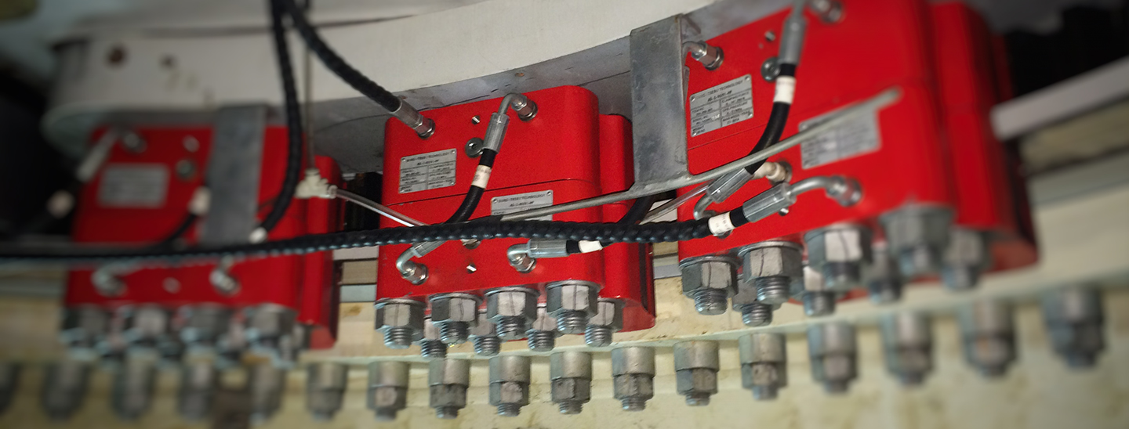
Component manufacturing
Hydraulic brakes, Trebu, Rotterdam

Slide 17
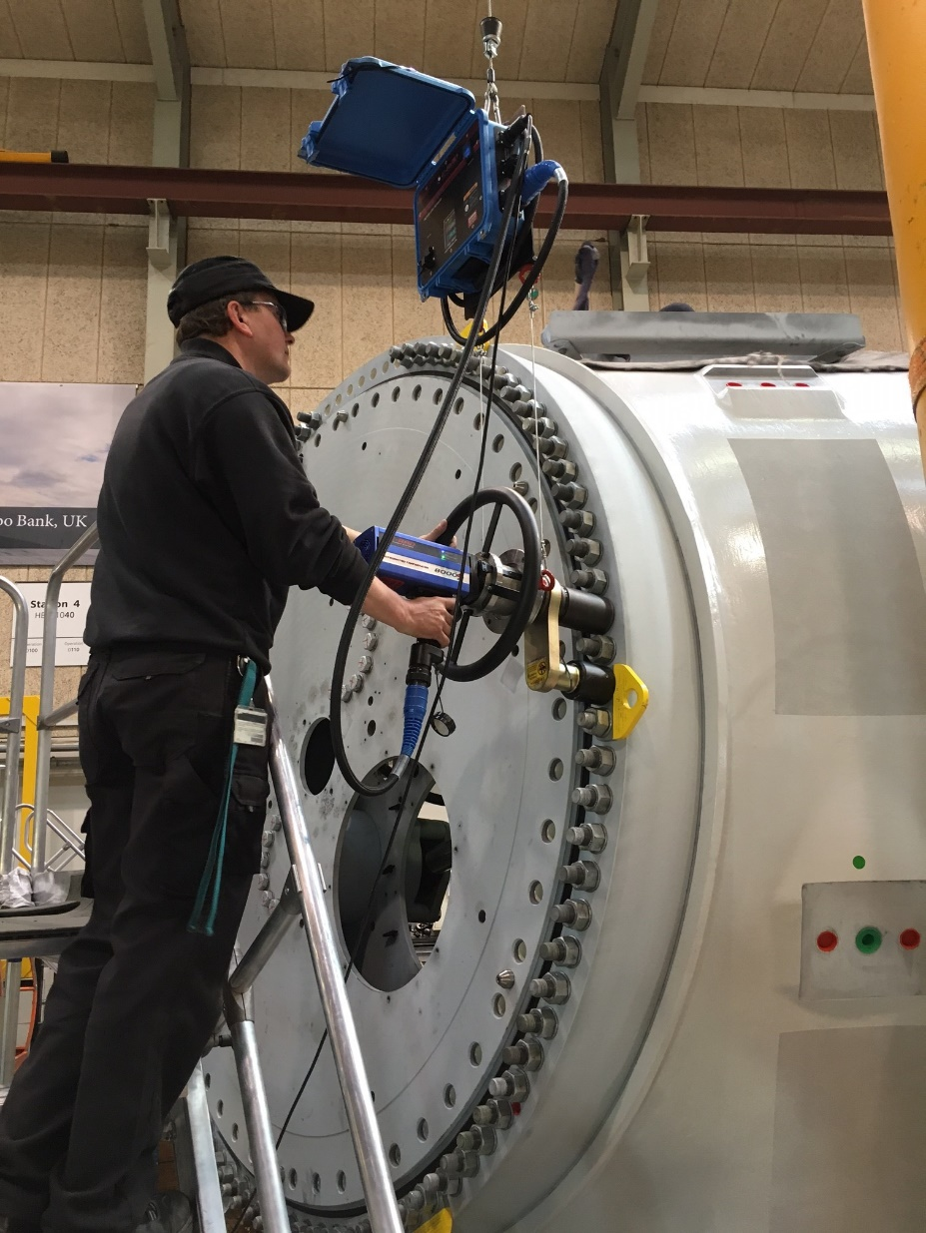
Components assembly
Siemens Brande
GE Salzbergen
Applications
Pitch bearing
Shrink disc
Complete hub

Slide 18
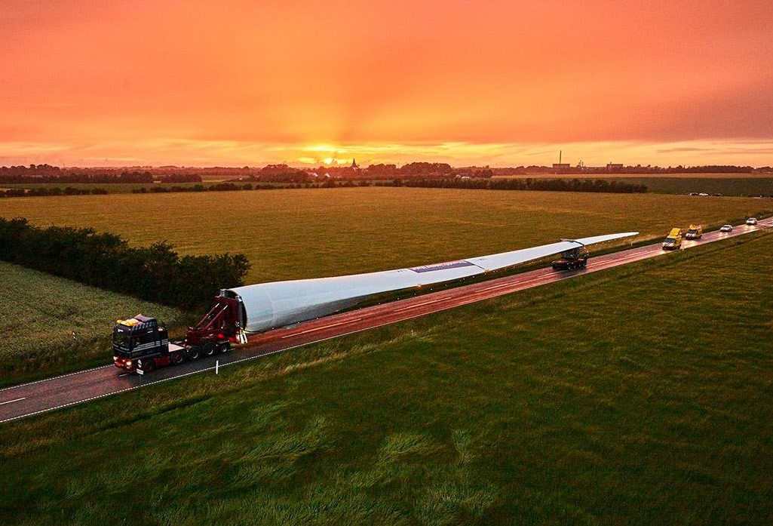
Transportation of turbine parts
Blades on trucks and vessels
Many parts are secured with bolts

Slide 19
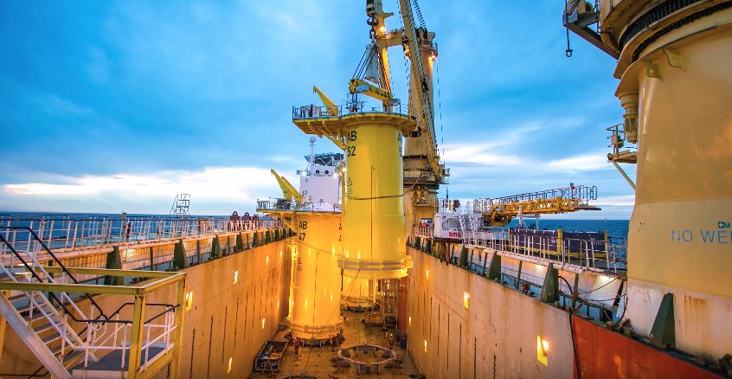
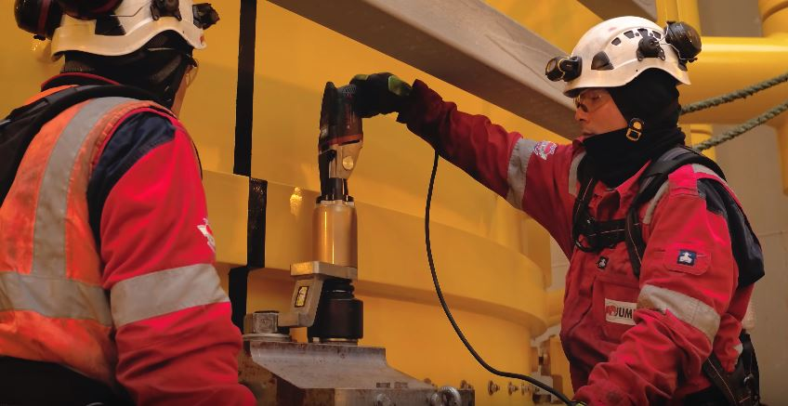
Transportation offshore (sea fastening)
Transition piece (TP) transport
MV-RAD 80 for TP seafastening
Usually with deep socket and
deep socket reaction arm

Slide 20
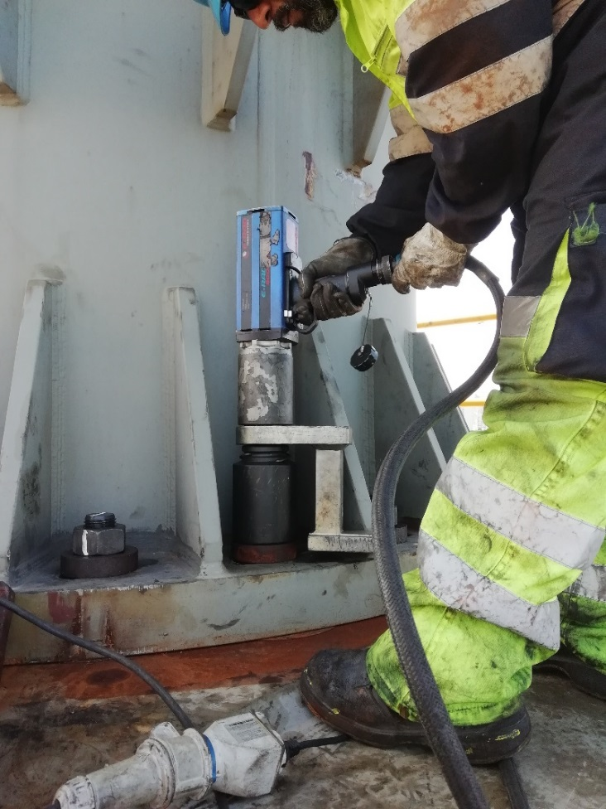
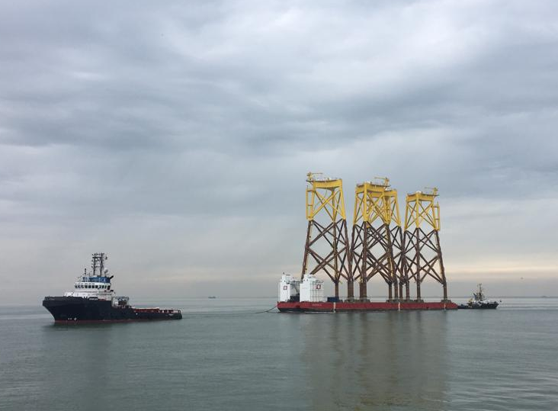
Transportation offshore (sea fastening)
Jacket foundation

Slide 21
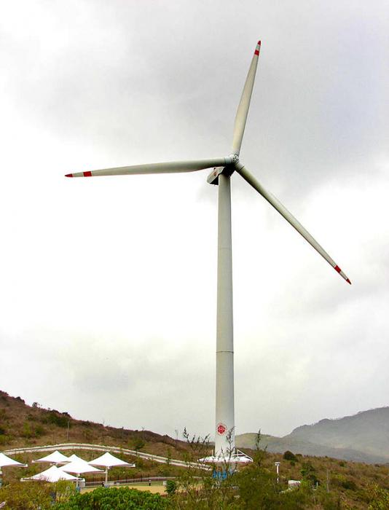
Turbine erection
Tower flanges
Onshore:
M64 – M36
Offshore:
M72 – M36
Tower - nacelle
Nacelle – hub
Blades – hub
M36
M42
M48
M64

Slide 22
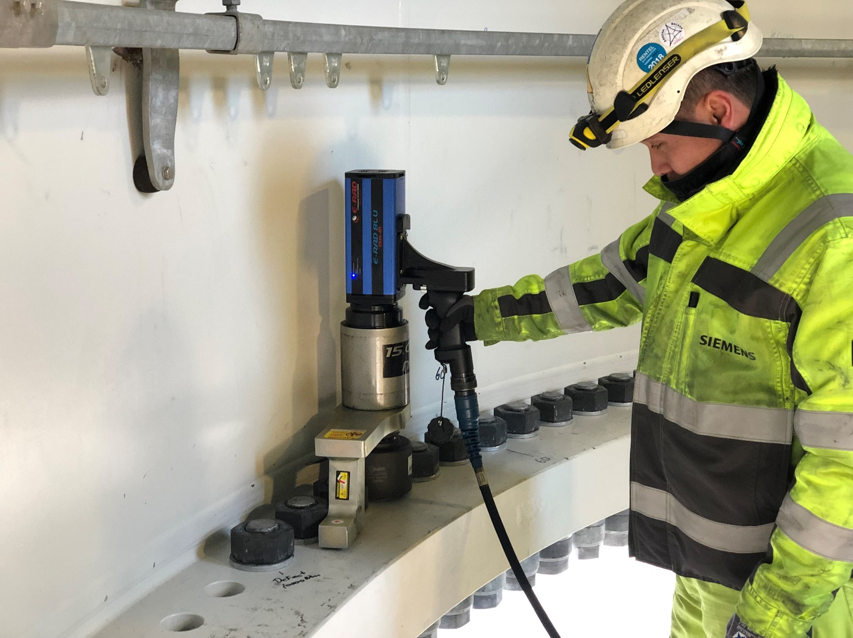
Turbine installation: tower flanges
Final torque, or pre-torque up to 16.500 Nm
Hydraulic torque wrenches or tensioners
are used for torques up to 23.000 Nm

Slide 23
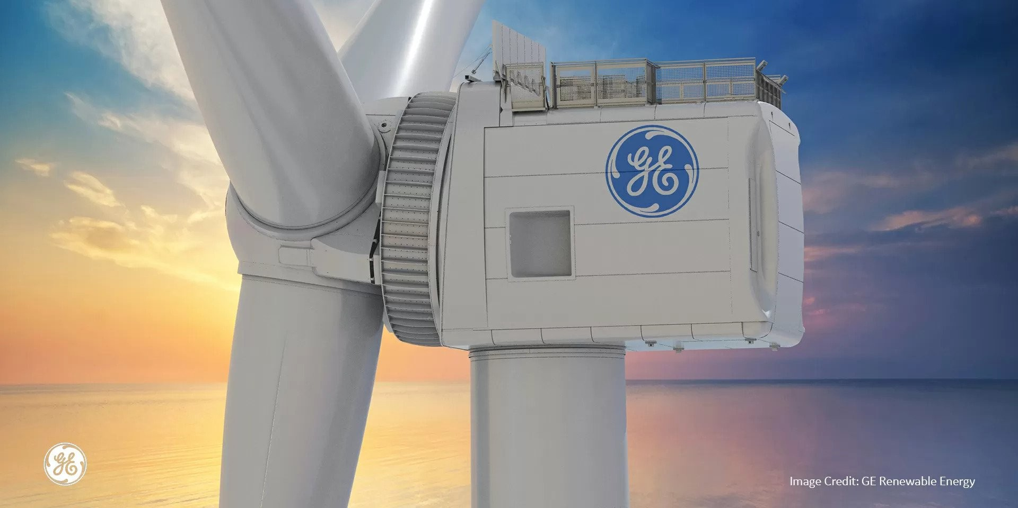
Turbine installation: tower - nacelle

Slide 24
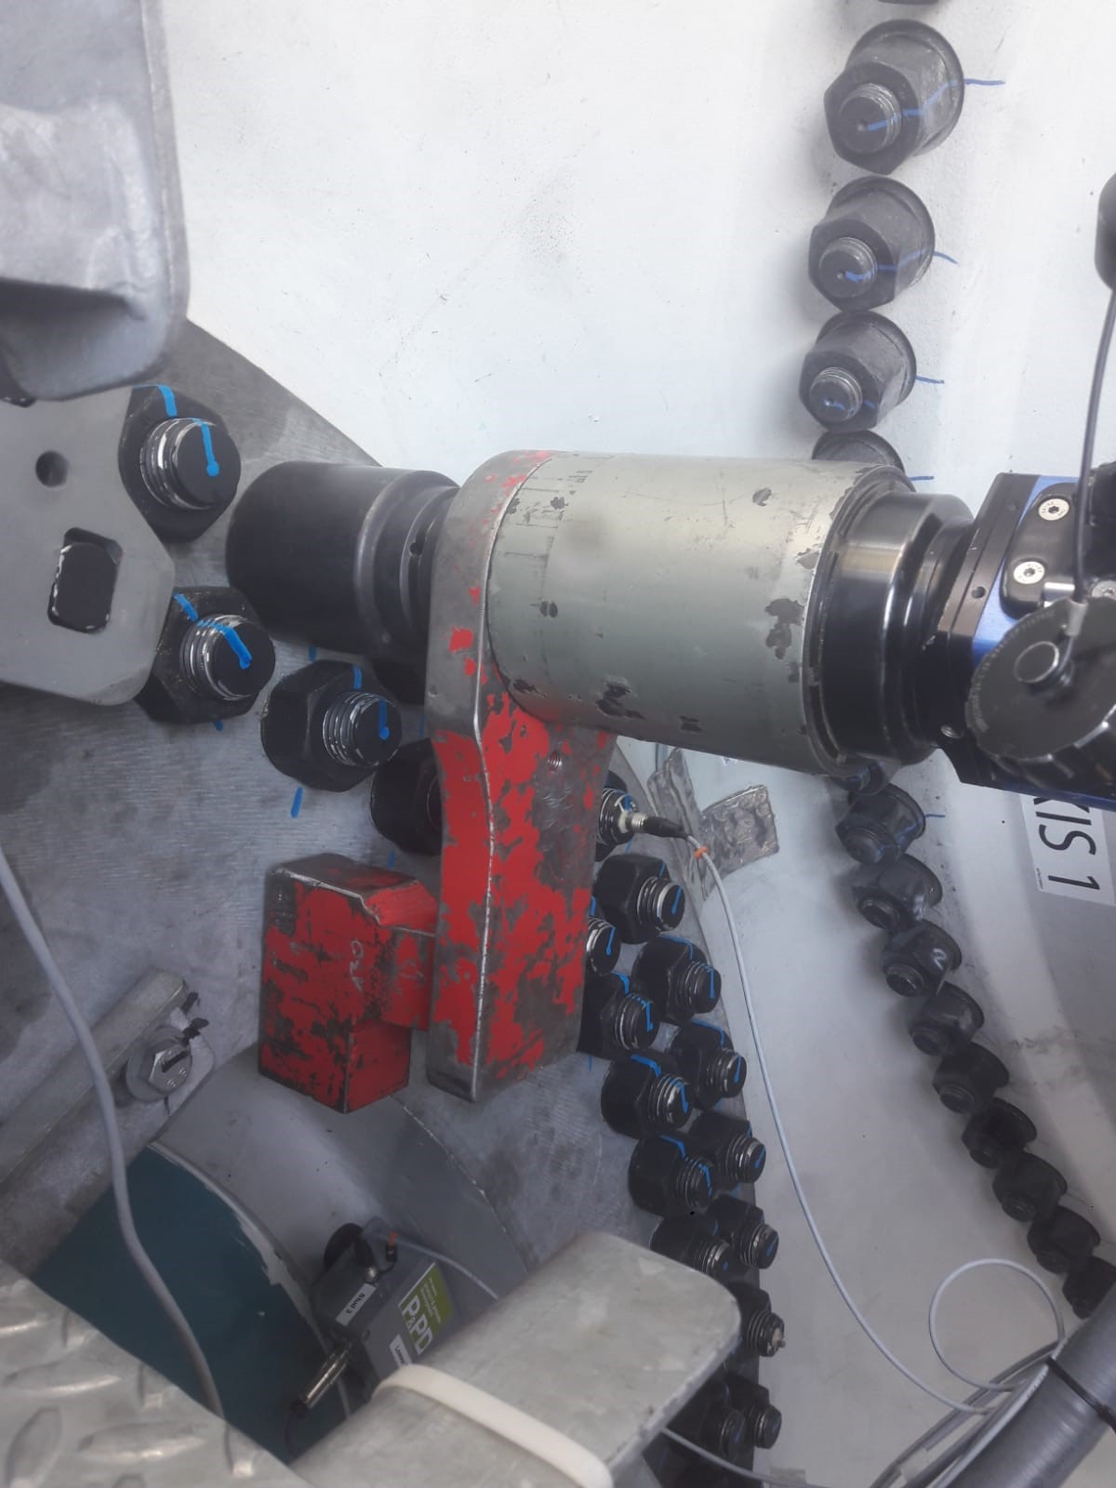
Turbine installation: nacelle - hub

Slide 25
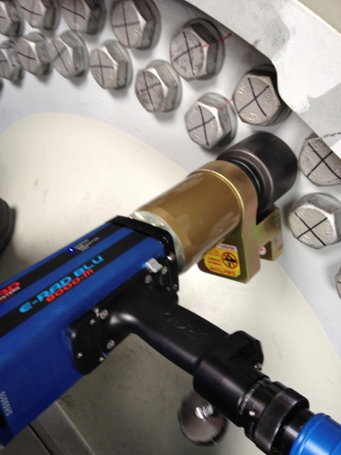
Turbine installation: main shaft connection
E-RAD 8000

Slide 26
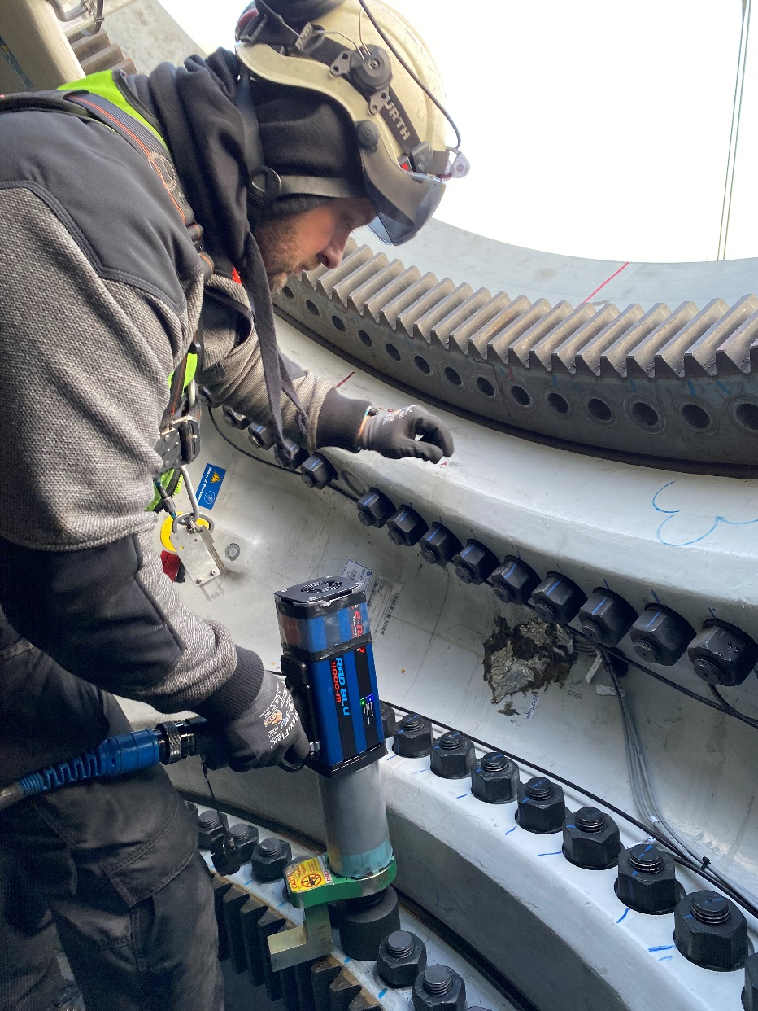
Turbine installation: blades - hub
E-RAD 4000

Slide 27
300 hours service
Newly erected wind turbines all need a 300 hour service job.
During this service the complete turbine is checked.
Bolt check on all critical joints:
E-RAD
MV-RAD
MB-RAD

Slide 28
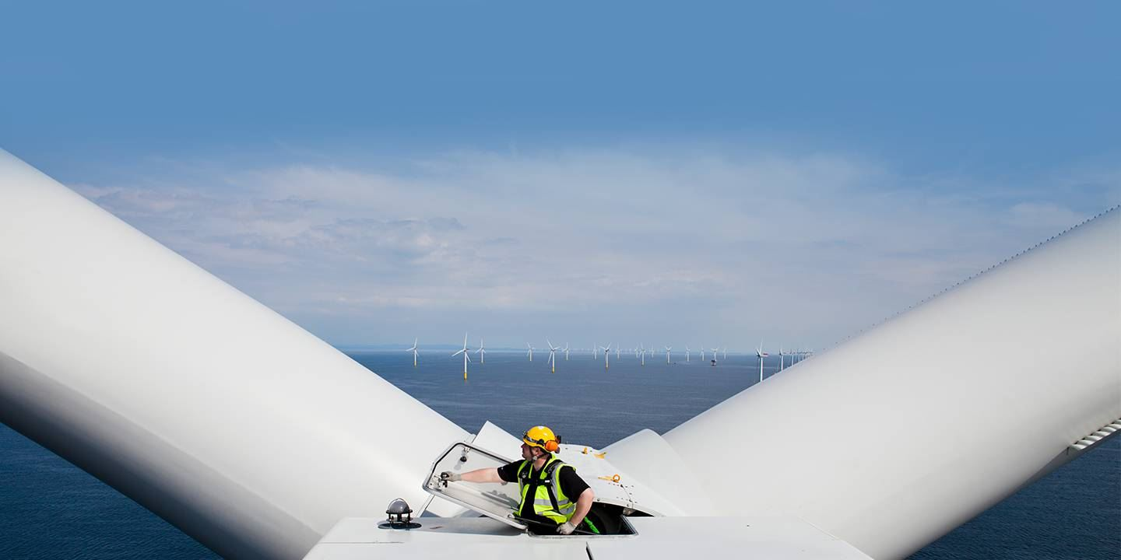
Service & repairs
Exchanging components

Slide 29
RAD competitors in the wind industry
ITH
Plarad
Acradyne
Hytorc
Atlas Copco

Slide 30
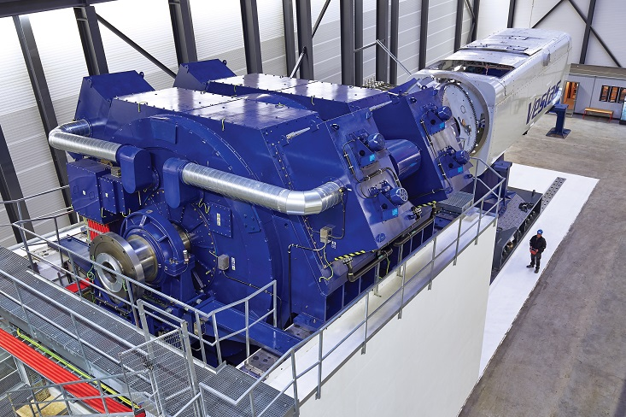
Certification labs
Lorc, Denmark

Slide 31
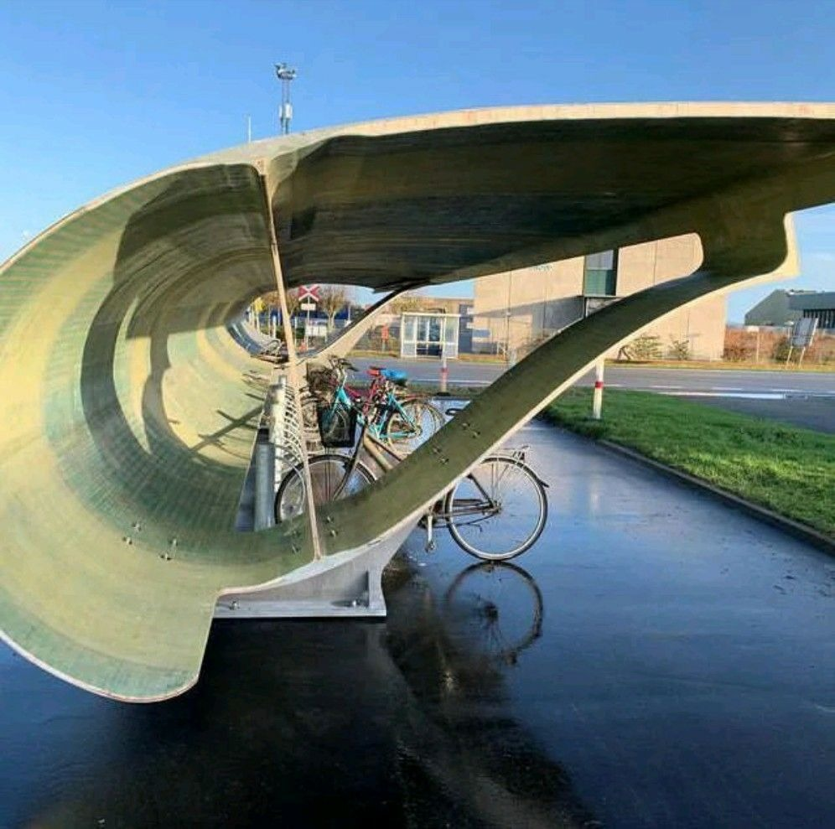
Recycling of wind turbines
Repowering

Slide 32


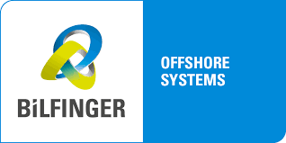








References in the wind industry

Slide 33
Alternative bolting methods
Hydraulic
Tensioning

